Slide 1


Machine Learning for Cirrhotic Liver MRI Classification
Group 2: Michael Gomez, Vandan Gorade, Ziyan Zhu
Northwestern University

Slide 2
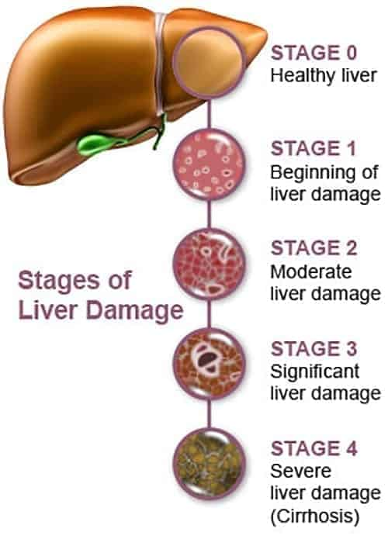
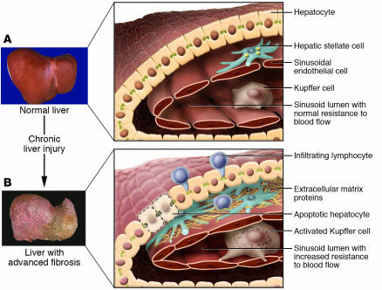
Background: Liver Cirrhosis
Global burden of chronic liver disease
Widely prevalent condition: Estimated 112 million people with compensated cirrhosis worldwide [1]
Deadly condition: Associated with 2.4% of global deaths [1] [2]
Associated with obesity, high alcohol consumption, and autoimmune diseases
Fibrosis
Condition presents with increased hardening/thickening of the liver
[1] Huang et al. Nat Rev Gastroenterol Hepatol. 2023
[2] Moon et al. Clinical Gastroenterology and Hepatology. 2020
[4] Bataller. J Clin Invest. 2005
[3] American Liver Foundation

Slide 3
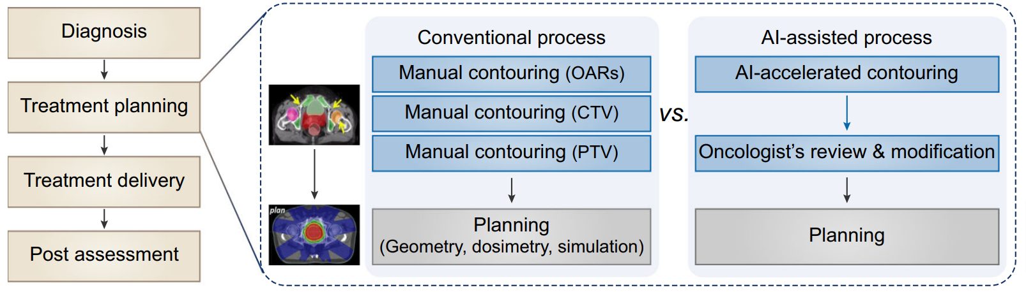
AI for Optimizing Medical Workflow
Integrating AI in medical workflows can save radiologist
time and can increase efficiency
[5]. Shi, F., Hu, W., Wu, J. et al. Deep learning empowered volume delineation of whole-body organs-at-risk for accelerated radiotherapy. Nat Commun 13, 6566 (2022).
Motivation
Notes:
Medicine and black box AI

Slide 4
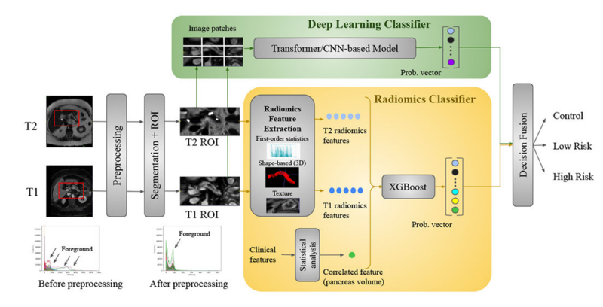
Background: AI for Optimizing Medical Workflow
Cirrhosis Diagnosis
Current gold standard for diagnosis = tissue biopsy
Invasive procedure, potential risks
MRI Imaging
Powerful and widely available diagnostic tool
T1 vs. T2 modalities
T1 contrast optimized for tissue structures (fatty anatomy)
T2 contrast optimized for fluid visualization (abnormalities like inflammation and tumors)
Applications of Machine/Deep Learning
Image Segmentation vs. Image Classification, Computer-Aided Diagnosis, Decision Making Support
[6] Yao, Lanhong,. et al. Mach Learn Med Imaging. 2023

Slide 5
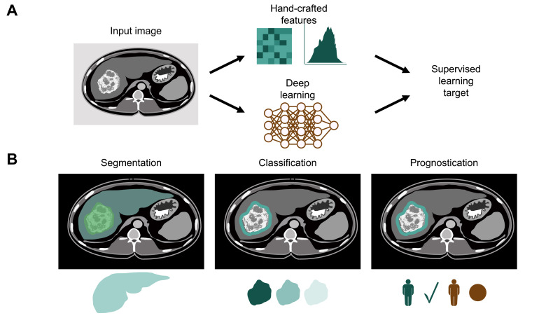
Background: Our Dataset
CirrMRI600+
Open source dataset for high-resolution MRI images
Large scale = over 600 patient samples
Preprocessed and separated 80/10/10 for training, validation, and testing
Data:
3D volumetric MRI scans
Manually segmented truth masks
Radiologist observations = labels
1 = mild
2 = moderate
3 = severe
Goal: To accurately predict the stage of cirrhosis from MRI images. Based on severity, cirrhotic MRIs are classified into 3 stages: mild, moderate, and severe

Slide 6
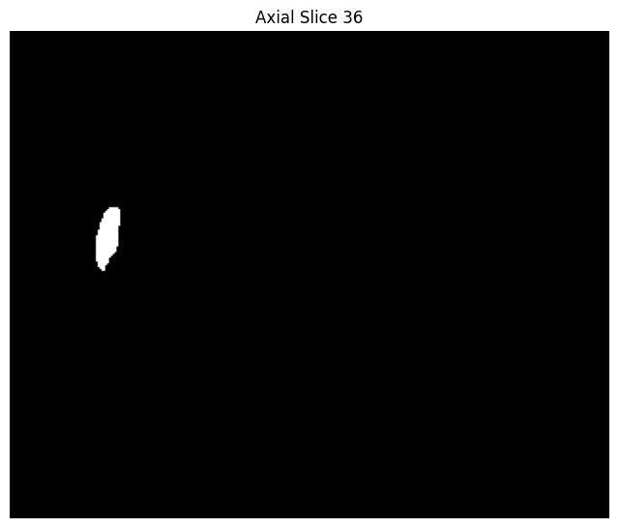
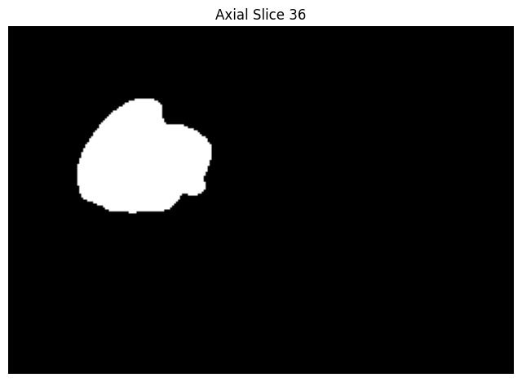
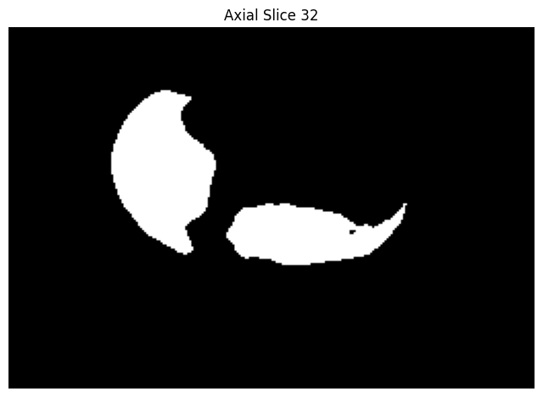
Methods: PyRadiomics
Feature Dataset:
First order statistics (19 features)
Shape-based 3D (16 features)
Shape-based 2D (10 features)
Gray level Co-occurrence Matrix (24 features)
Gray Level Size Zone Matrix (16 features)
Gray Level Run Length Matrix (16 features)
Neighbouring Gray Tone Difference Matrix (5 features)
Gray level Dependence Matrix (14 features)
Image Masks
Feature Extractor

Slide 7
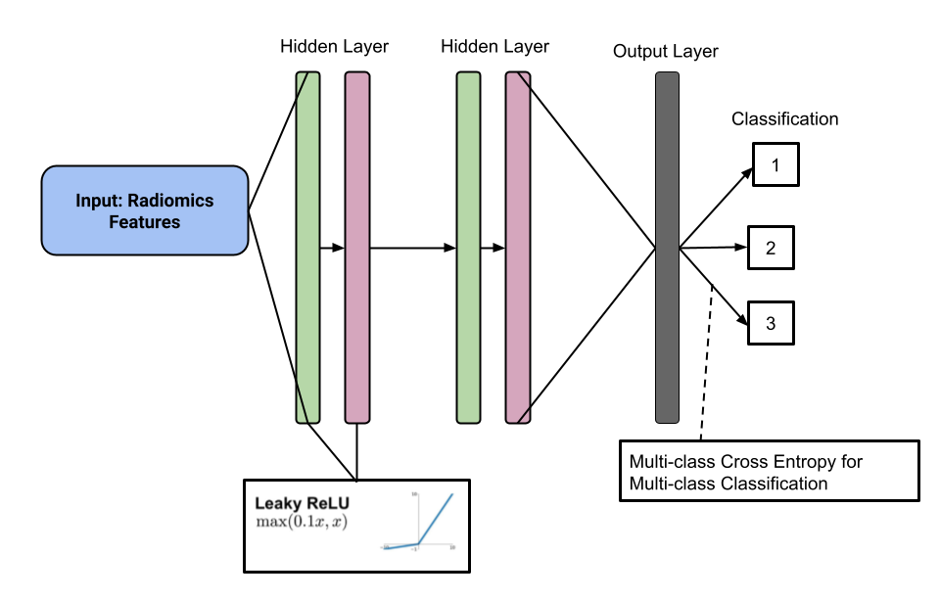

Methods: ML Models
Random Forest
Sklearn RandomForestClassifier
With/without pruning and parameter tuning
Feed Forward Neural Network

Slide 8
Results: Random Forest
T1 Model: Test Accuracy = 0.48
 | Class 1 | Class 2 | Class 3
Precision | 0.60 | 0.29 | 0.25
Recall | 0.71 | 0.33 | 0.12
F1-Score | 0.65 | 0.31 | 0.17
T2 Model: Test Accuracy = 0.48
 | Class 1 | Class 2 | Class 3
Precision | 0.62 | 0.33 | 0.33
Recall | 0.62 | 0.50 | 0.22
F1-Score | 0.62 | 0.40 | 0.27
With Pruning: Test Accuracy = 0.52
 | Class 1 | Class 2 | Class 3
Precision | 0.61 | 0.40 | 0.38
Recall | 0.65 | 0.33 | 0.38
F1-Score | 0.63 | 0.36 | 0.38
With Pruning: Test Accuracy = 0.58
 | Class 1 | Class 2 | Class 3
Precision | 0.60 | 0.50 | 0.57
Recall | 0.75 | 0.33 | 0.44
F1-Score | 0.67 | 0.40 | 0.50

Slide 9
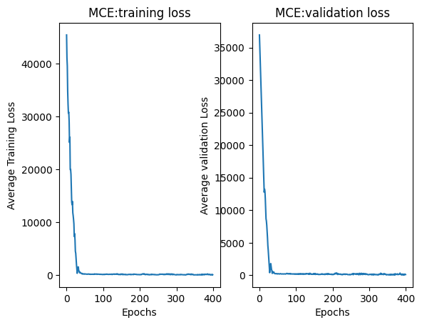
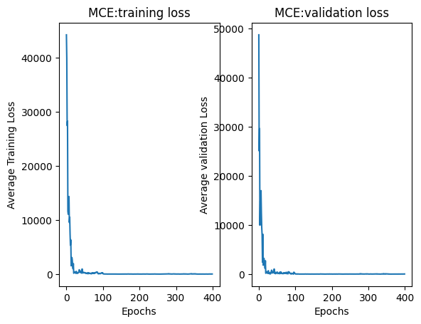
Results: Neural Network
T1
T2
Final Test Accuracy: 0.55
Final Test Accuracy: 0.52

Slide 10
Discussion
Model Performance
Random Forest baseline vs. neural network
T1w vs. T2w modality
Improvements
Hyperparameter tuning
Radiomics dataset
Future Directions
Refining ML radiomics approach vs. incorporating DL techniques

Slide 11
References
[1] Huang, D.Q., Terrault, N.A., Tacke, F. et al. Global epidemiology of cirrhosis — aetiology, trends and predictions. Nat Rev Gastroenterol Hepatol 20, 388–398 (2023). https://doi.org/10.1038/s41575-023-00759-2
[2] Andrew M. Moon, Amit G. Singal, Elliot B. Tapper, Contemporary Epidemiology of Chronic Liver Disease and Cirrhosis, Clinical Gastroenterology and Hepatology, Volume 18, Issue 12, 2020, Pages 2650-2666, ISSN 1542-3565, https://doi.org/10.1016/j.cgh.2019.07.060.
[4] Bataller R, Brenner DA. Liver fibrosis. J Clin Invest. 2005 Feb;115(2):209-18. doi: 10.1172/JCI24282. Erratum in: J Clin Invest. 2005 Apr;115(4):1100. PMID: 15690074; PMCID: PMC546435.
[5] Shi, F., Hu, W., Wu, J. et al. Deep learning empowered volume delineation of whole-body organs-at-risk for accelerated radiotherapy. Nat Commun 13, 6566 (2022).
[6] Yao, Lanhong,. et al. “Radiomics Boost Deep Learning Model for IPMN Classification.” Mach Learn Med Imaging. 2023 October; 14349: 134–143. doi:10.1007/978-3-031-45676-3_14.
[7] Gorade, V., et al. (2024). Towards synergistic deep learning models for volumetric cirrhotic liver segmentation in MRIs. arXiv. https://arxiv.org/abs/2408.04491

